Slide 1

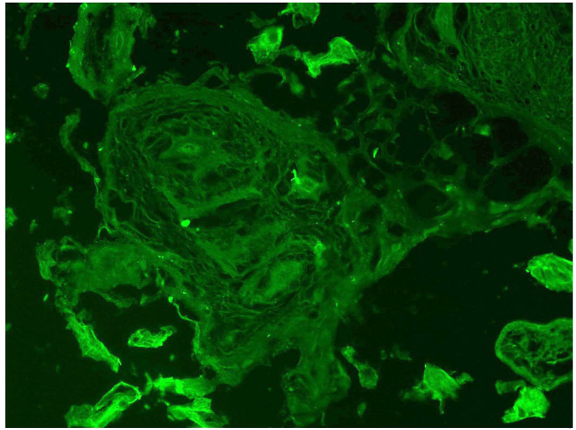
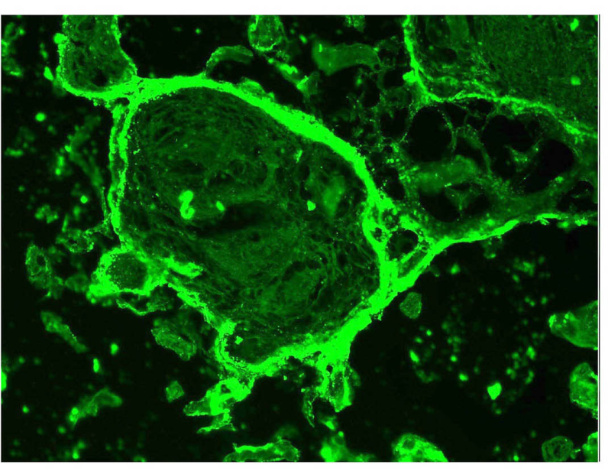
ReliaTech GmbH
Anti-human PlGF antibody #3B10
(Cat# 101-M65)
Human Placenta villous (cryo section):
Control without primary antibody (parallel section).
Anti-human PlGF #342/3B10.
Note, that the syncytiothroblast layer is positiv for PlGF but not other fetal cells insite the trophoblast villi.
The experiment was performed by PD. Dr. Jörg Wilting, Pädiatrie I, Zentrum für Kinderheilkunde und Jugendmedizin in Göttingen, Germany.
http://www.reliatech.de / orders@reliatech.de

